Slide 1
Fda project analysis
Analysis Report For SQL Assignment
Submitted By-
Vattandeep Kaur
ABADS
Batch- 12

Slide 2
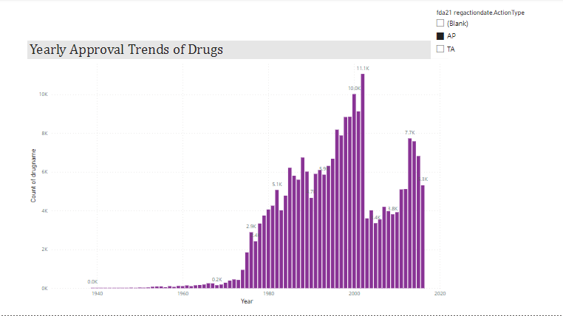
Yearly approval trends of drugs
The bar graph shows the yearly approval trends of drugs. The graph shows that the count of approved drugs started increasing from 948 in the year 1974 and went up the highest at the count of 11057 in 2002.
After 2002, it fell down to 3603, the lowest after 28 years. But it started rising gradually.

Slide 3
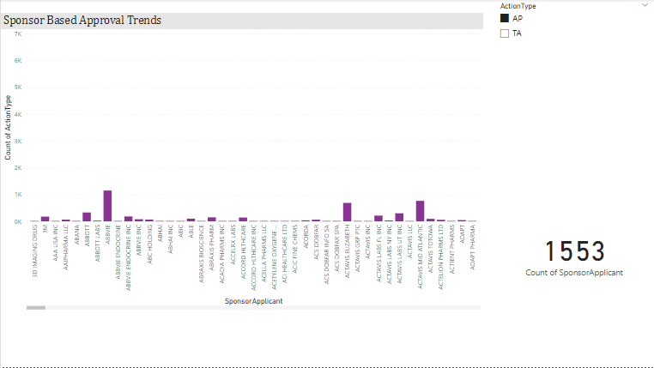
Sponsor based approval trends of drugs over the years
The column chart shows the approval trends over the years based on different sponsors.
To check the count of different sponsors, the slicers has been added.

Slide 4
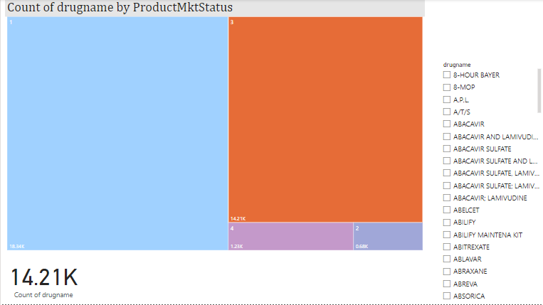
Marketing status based segmentation of products
The tree map has been used to represent the segmentation of products based on different Marketing Status.
The total count of drugs is 34,465. For different segments, its values can be seen from the tree map itself.
To find out the count of a particular drug, a slicer has been used.

Slide 5
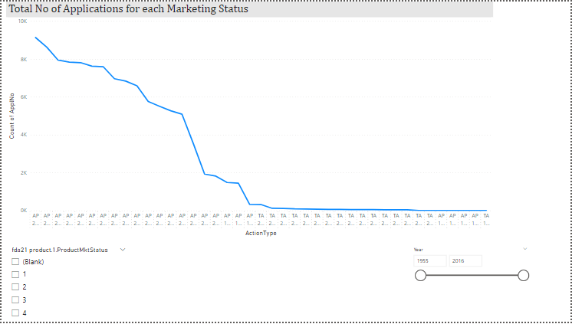
Total number of applications for each marketing status
Analysis of distribution of approvals across different forms can be seen from the line chart.
Slicers has been added to check marketing status and yearly basis trends.

Slide 6
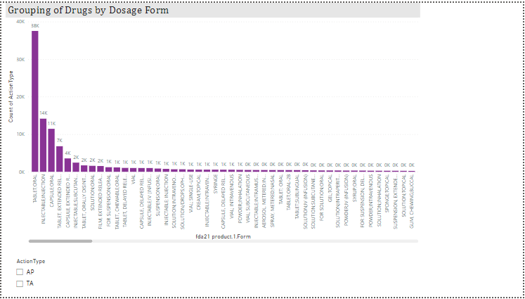
Grouping of drugs by dosage form & distribution of approvals across different forms
The grouping of drugs by dosage form and distribution of approvals across different forms can be seen from the bar graph.
To check the approvals, a slicer has been added.
The first three dosage forms- Tablet; Oral, Injectable; Injection and Capsule; Oral, are the most successful as they have the highest count.

Slide 7
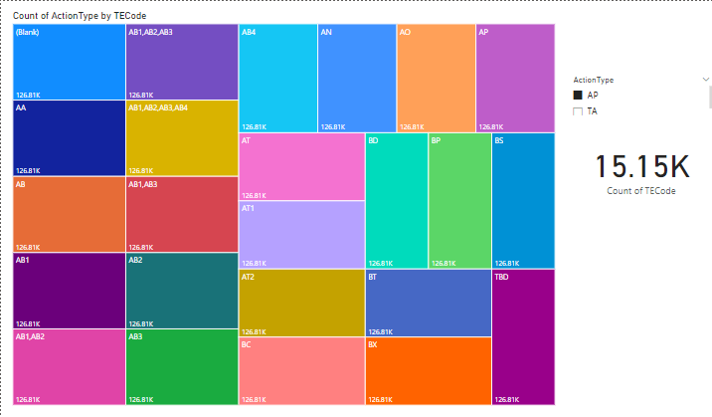
Therapeutic classes based drug approvals
The drug approvals based on therapeutic classes can be clearly seen from the tree map.
We can click on the individual box to check the number of approvals and also slicer has been used to monitor the value otherwise.

